Slide 1
Handwritten Essay
Marking
Software
Group 15
1

Slide 2
Group Members
1
2
3
Sewwandi
D.W.S.N.
E/18/329
Abeywickrama
A.K.D.A.S.
E/18/010
Jayathilake
W.A.T.N.
E/18/156

Slide 3
Problem

Slide 4
Manual marking
Not efficient
Depends on the mood of the marker
Not consistent for all the student
Difficult when the class size increases

Slide 5
Solution

Slide 6
Tool to grade students’ handwritten essays by providing more consistent and objective grading.
Automates manual grading by using
Optical Character Recognition (OCR)
Natural Language Processing (NLP)
Machine Learning Model

Slide 7
Solution
Architecture

Slide 8
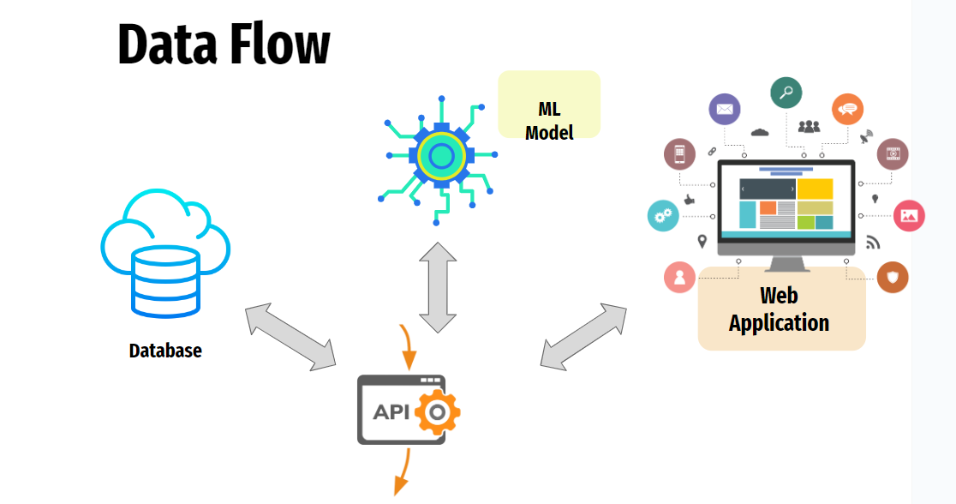

Slide 9
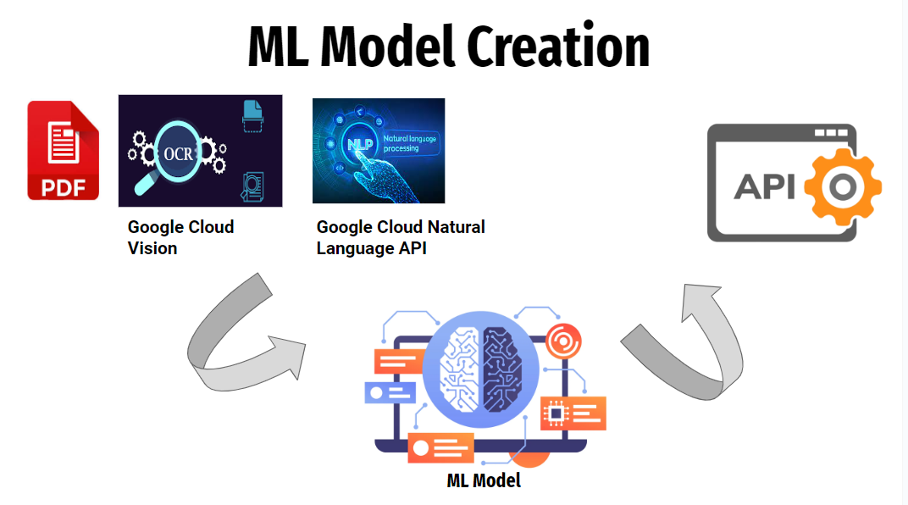

Slide 10
Technology
Stack

Slide 11


Slide 12
Demonstration

Slide 13
Thank you!

